Slide 1
GIVING VOICE TO THE
UNSPOKEN

Slide 2
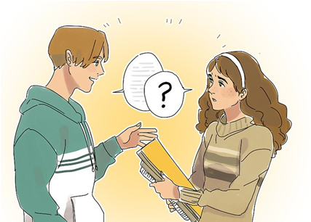
MAJOR PROBLEMS FACED BY THE DEAF AND MUTE:
Difficulty in communication

Slide 3
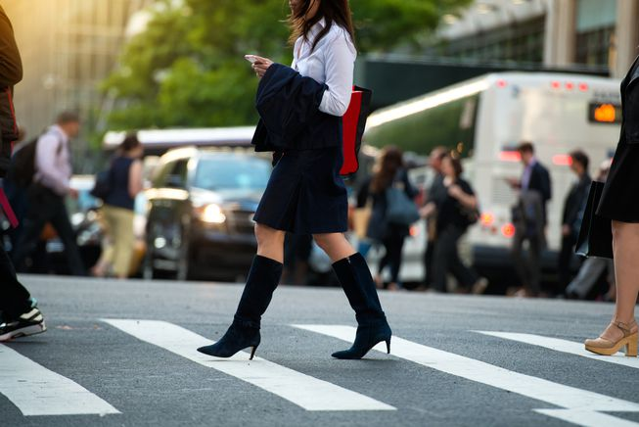
Question of road safety:

Slide 4
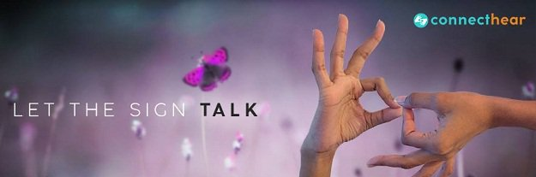
Deaf people make use of sign language or gestures to make understand
what he/she trying to say but it is impossible to understand by hearing people.

Slide 5
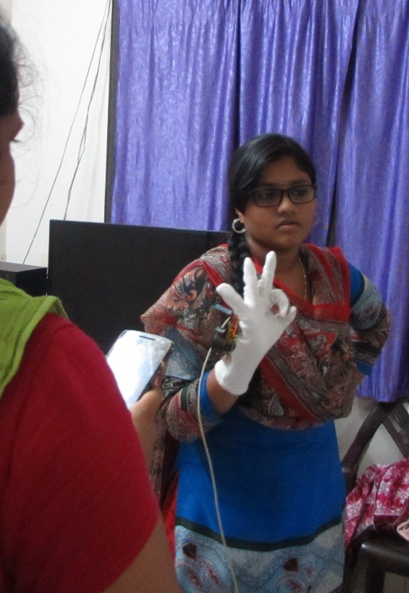
In the proposed model, sensors are placed on the hand of the deaf which convert the sensed signals from hand gestures to audio form.

Slide 6
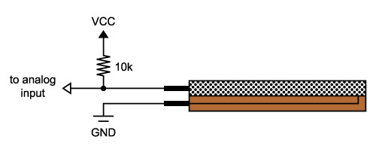
WORKING:
In detail, the flex sensors will detect the bending range scaled from 1 to 10 and an accelerometer will detect the x and y-axes motions.
FLEX SENSOR

Slide 7
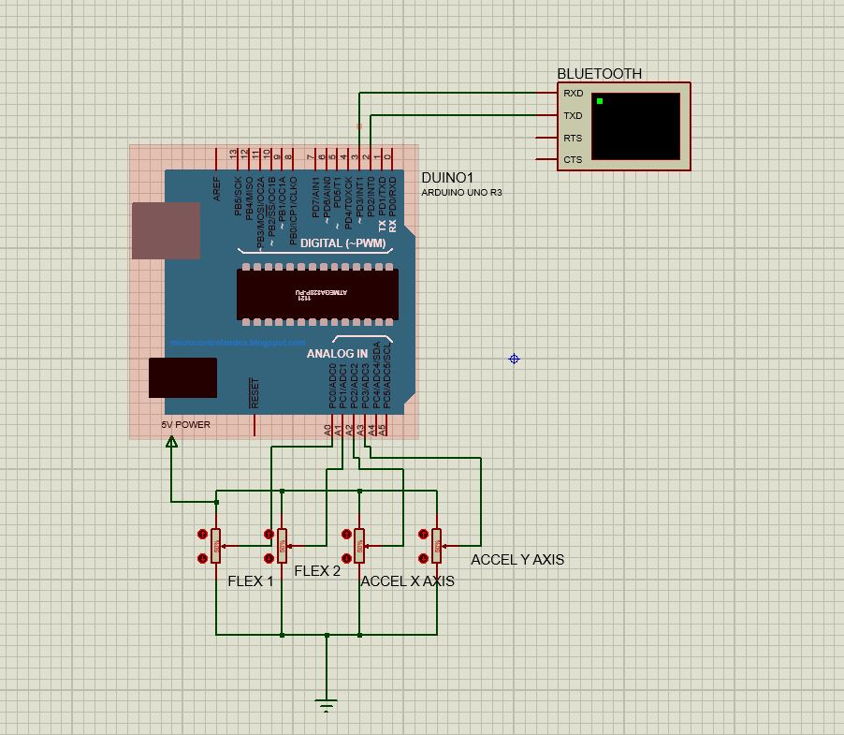
The corresponding data will be received through Arduino UNO.
This received text is sent to the mobile phone using a Bluetooth device.
An android app is used to convert text to voice.

Slide 8
APPLICATIONS:
Voice to text is implemented.
Phone call facility for deaf and mute.(future scope)

Slide 9
THE END

